Slide 1


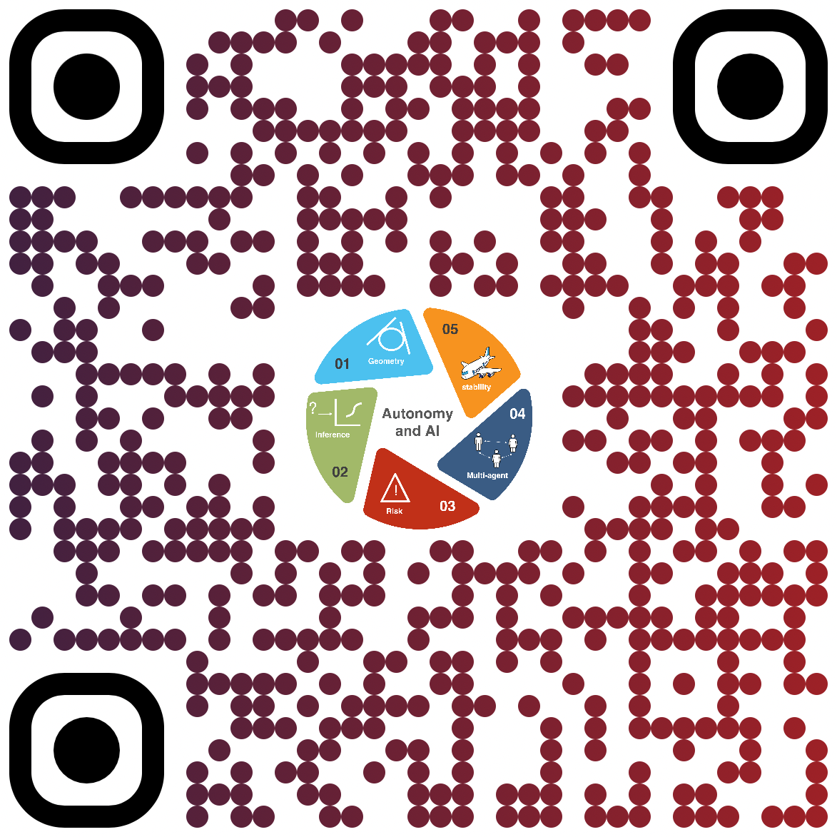
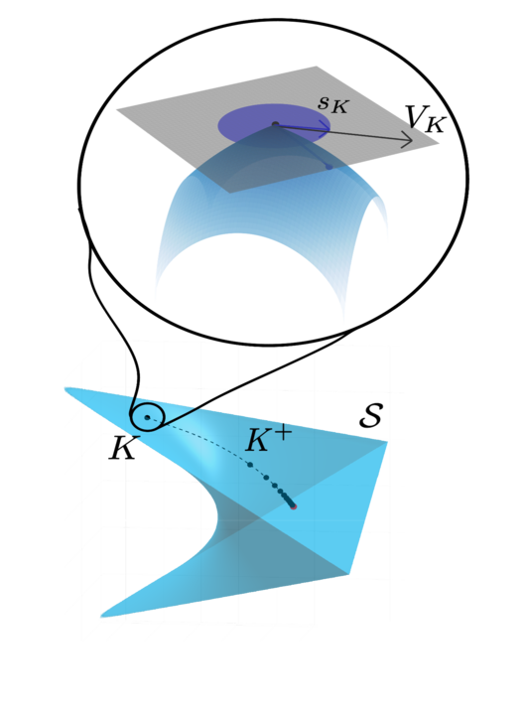

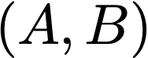
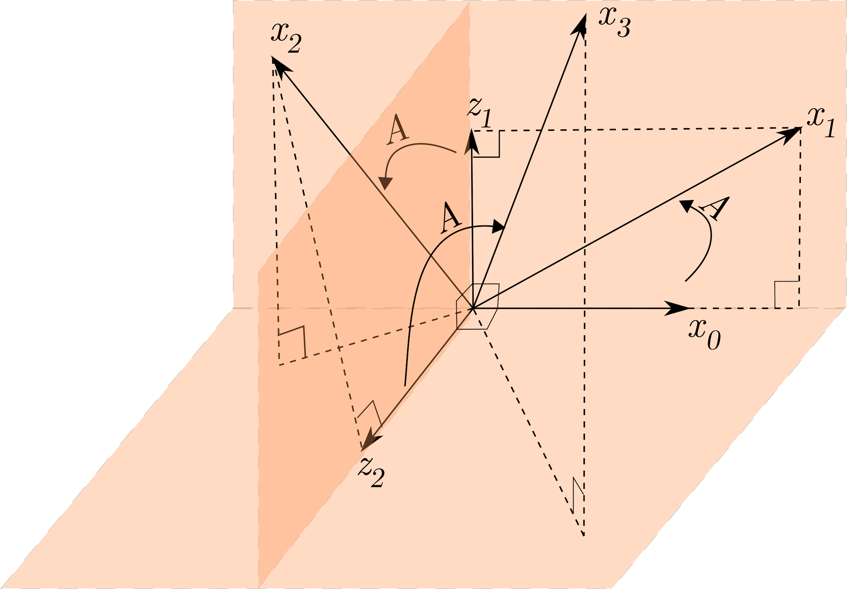
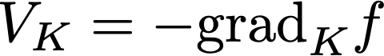
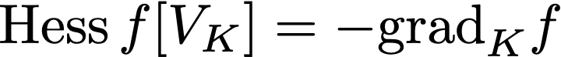

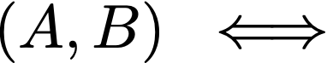
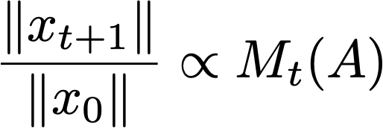
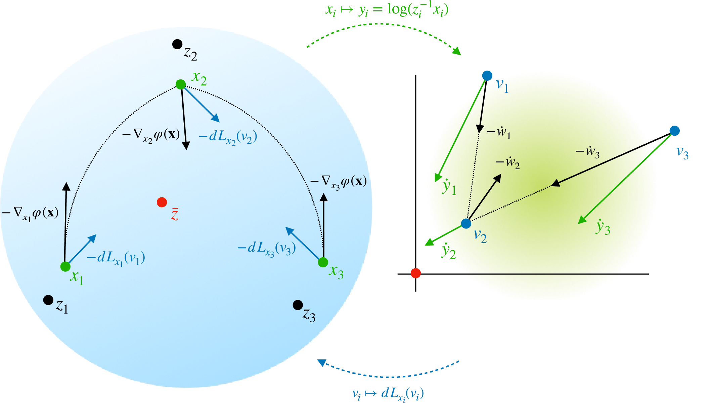
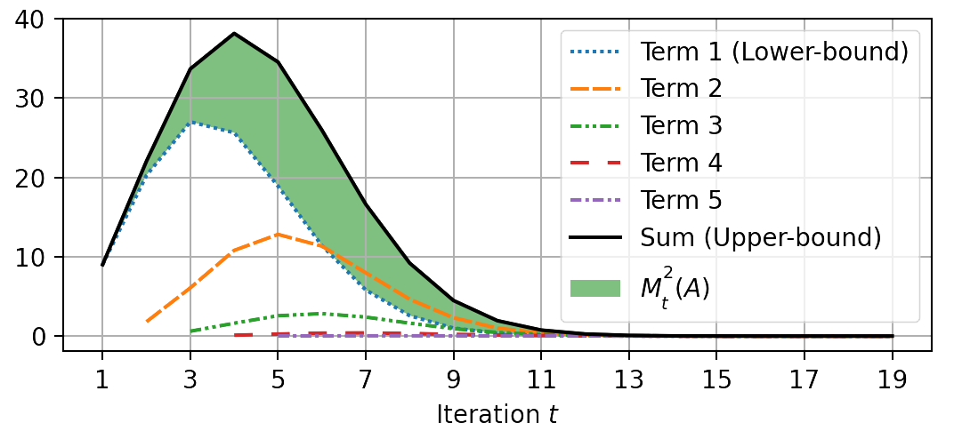
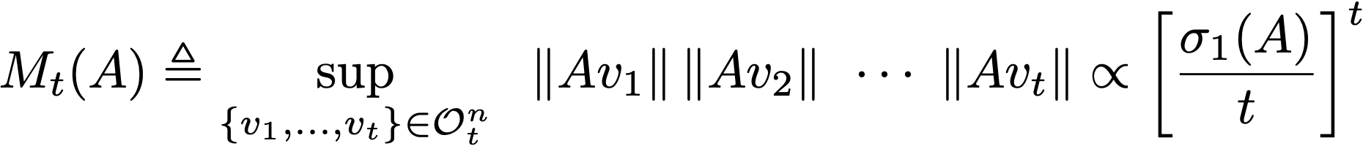
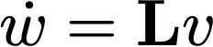
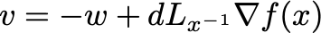
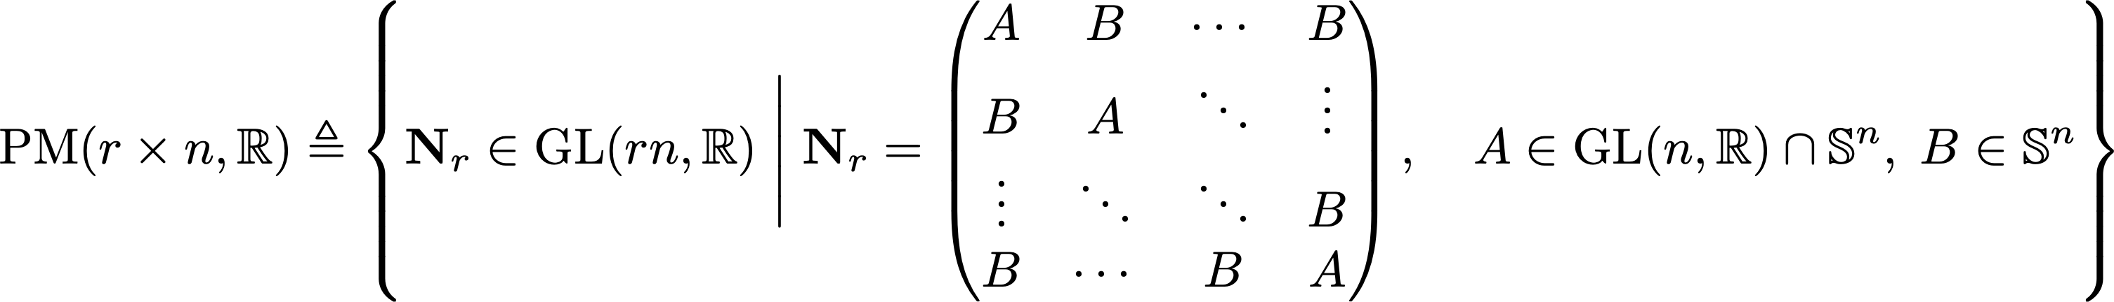

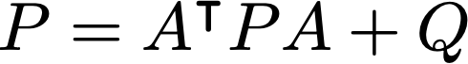
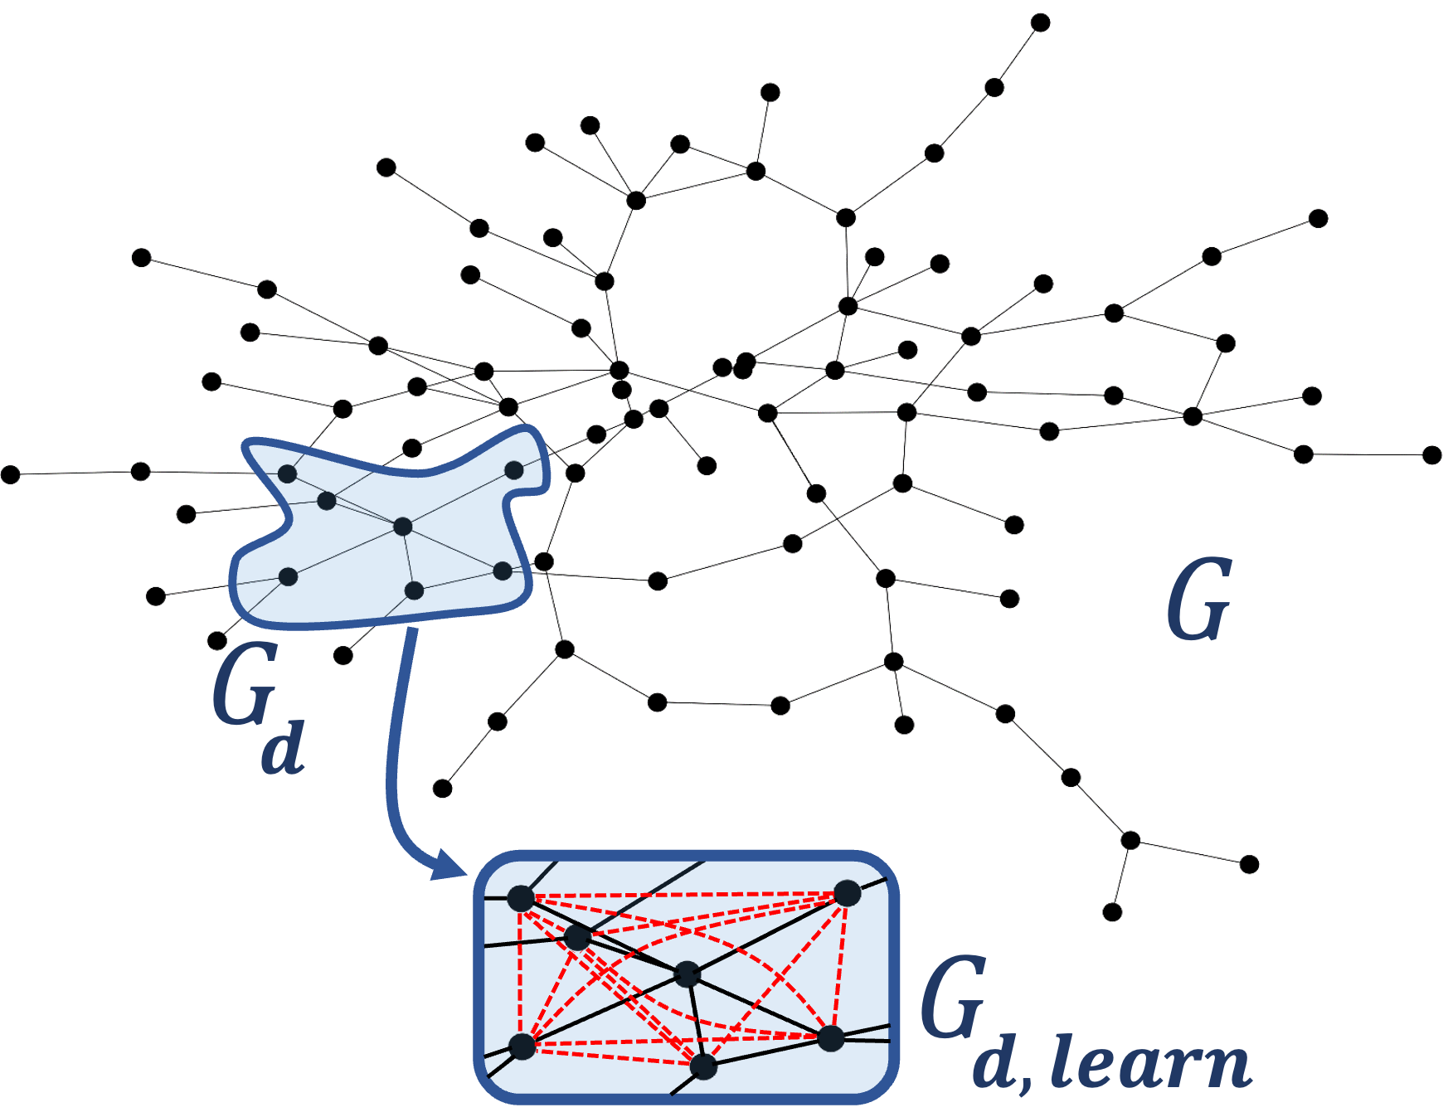
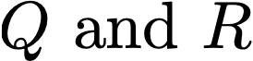
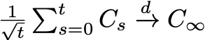
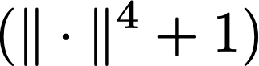
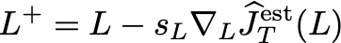
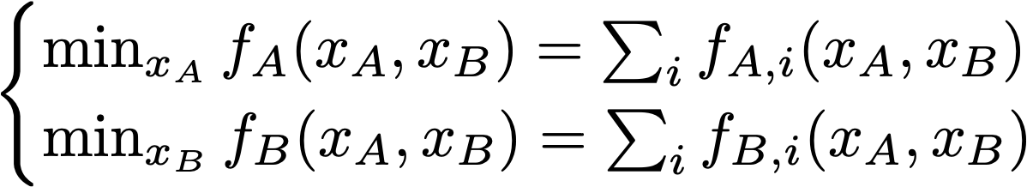
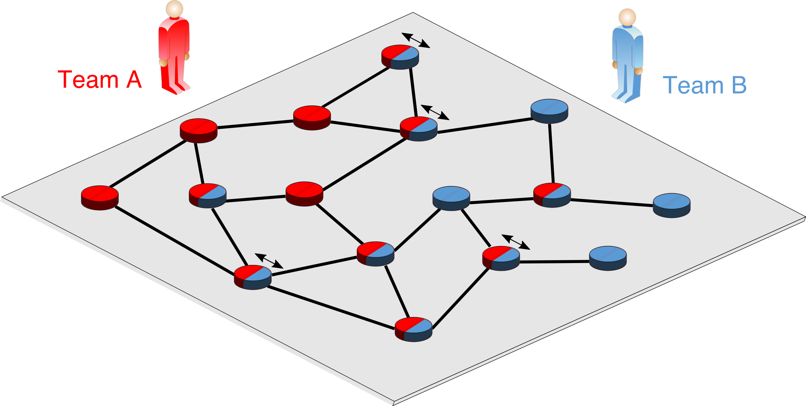
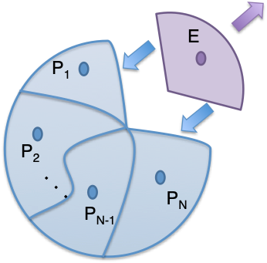
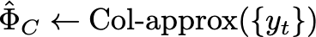
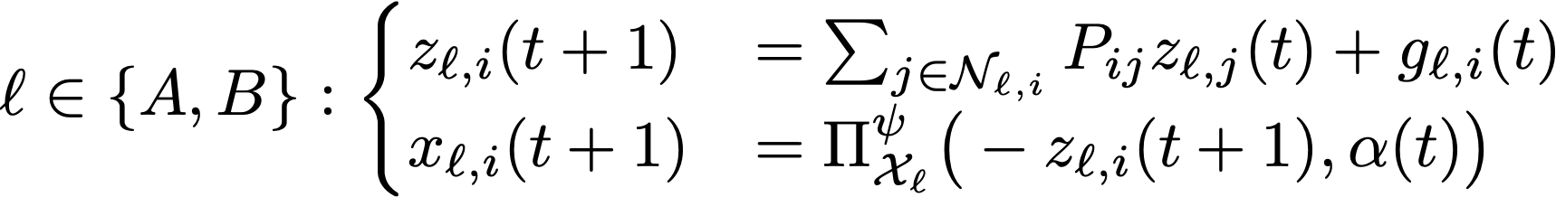
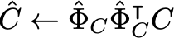
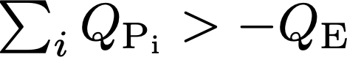
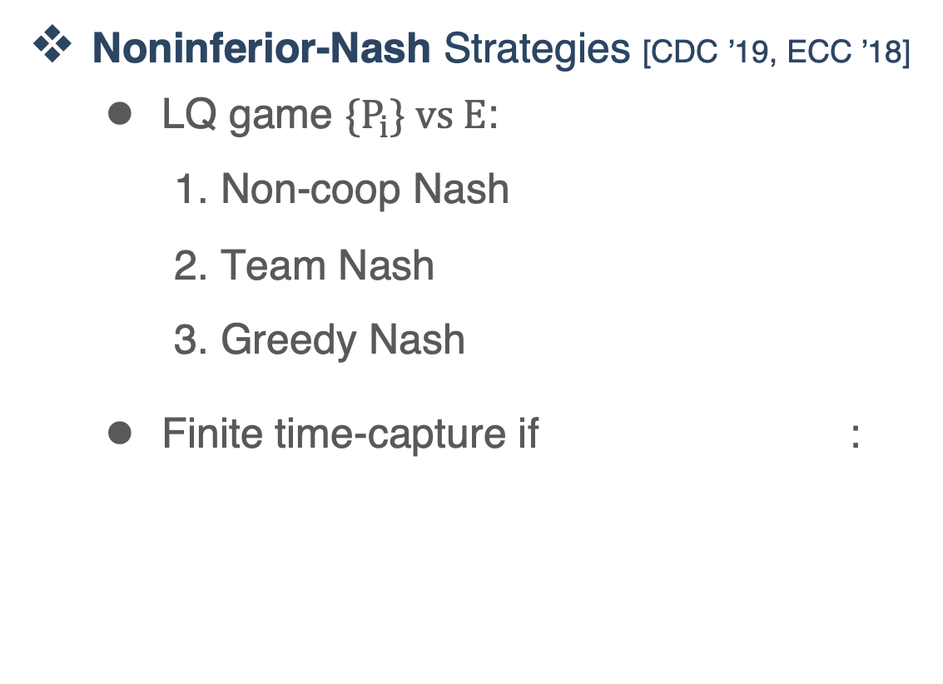
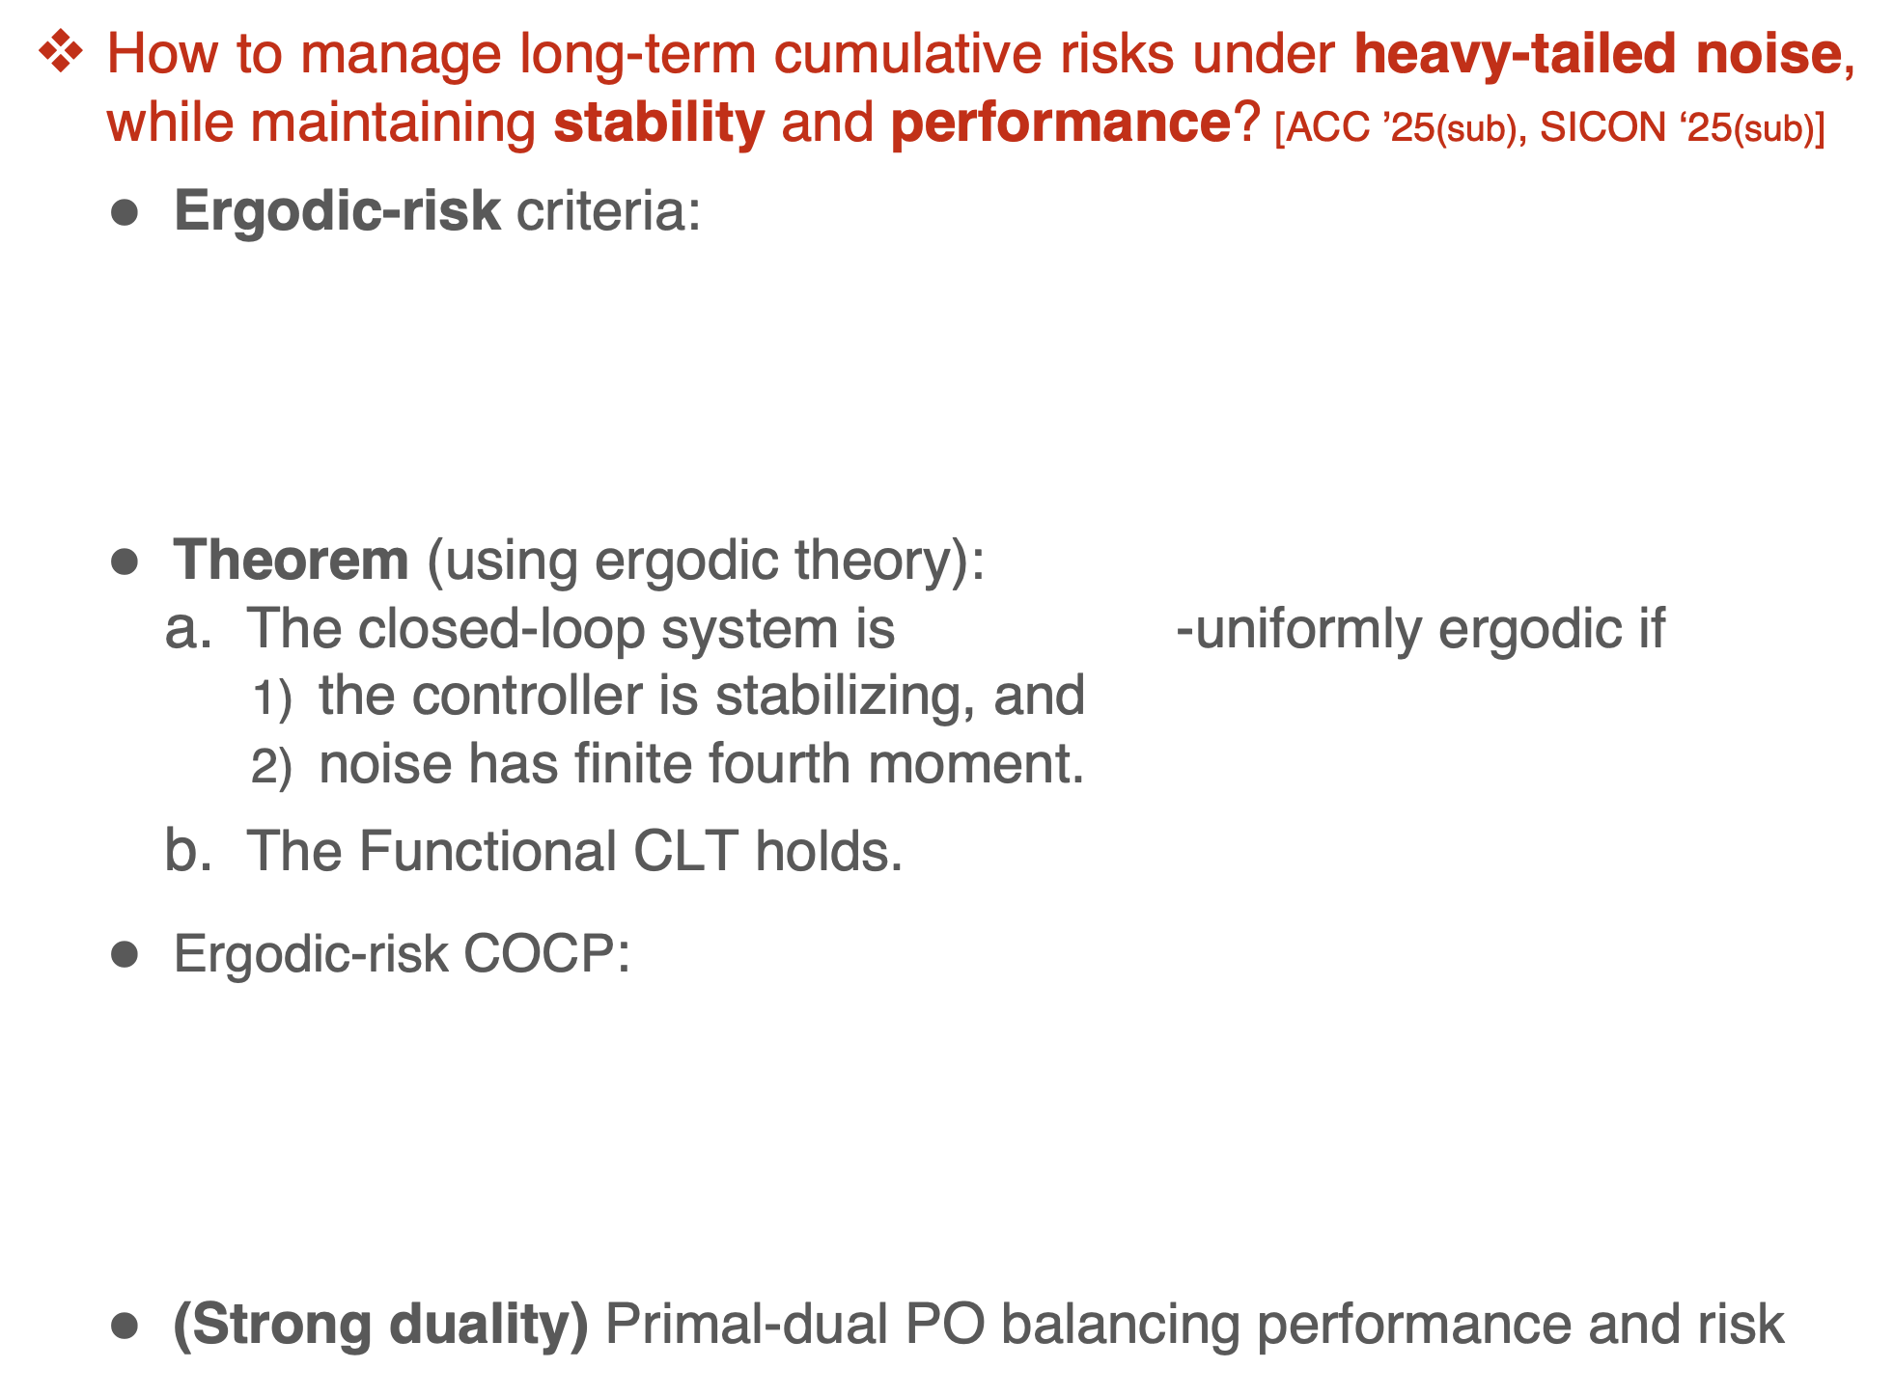
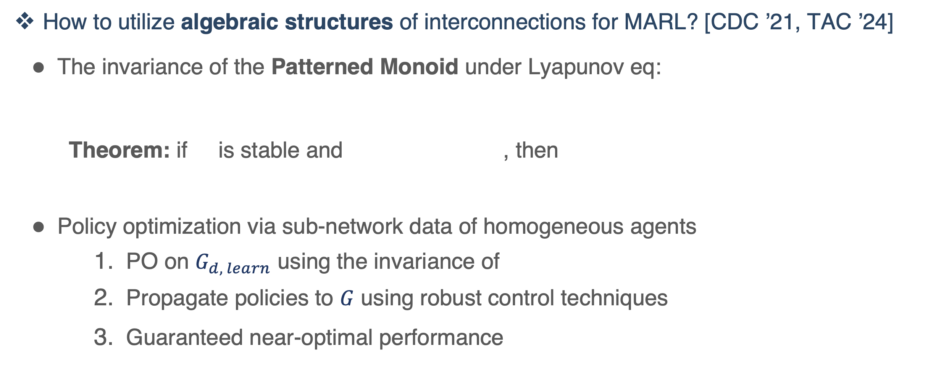
Shahriar Talebi (Harvard University)
01 - Geometry and Policies
05 - Online Stabilization
How to utilize the geometry of policies for learning efficiently under constraints? [CDC ’22, TAC ’24]
Riemannian geometry of stabilizing policies for LTI systems
Riemannian Gradient/Newton Descent for constrained LQR
RGD / RND:
05
Can we achieve real-time online stabilization and control for unstable systems? [CDC ’20, TAC ’22]
is Regularizable if is stable,
“a geometric criterion characterizing finite-time stabilization property”
Theorem: The certainty-equivalent minimum-energy control
stabilizes is regularizable,
generates informative data
Geometry
Stabilization
04
or
01
Autonomy
and AI
Performance guarantees:
The “instability number of order t”:
Geometric consensus to RCM on bi-invariant Lie groups: [CDC ’23, CCTA ’23]
RCM:
?
Multi-agent
Inference
02
!
03
Output-feedback and distributed stabilization
Geometric classification of control-affine systems
Risk
* Talebi, Alemzadeh, Rahimi, & Mesbahi, (2020). Online regulation of unstable linear systems from a single trajectory. IEEE Conference on Decision and Control (CDC), 4784–4789
* Talebi, Alemzadeh, Rahimi, & Mesbahi, (2022). On Regularizability and its application to online control of unstable LTI systems. IEEE Trans on Automatic Control (TAC), 67(12), 6413–6428
Generalization to robust, decentralized policies
Interactions with the geometry of stable manifolds
04 - Learning in Multi-agent Systems
* Talebi & Mesbahi, M. (2022). Riemannian constrained policy optimization via geometric stability certificates. 61st IEEE Conf on Decision and Control (CDC), 1472–1478
* Talebi & Mesbahi, M. (2024). Policy optimization over submanifolds for linearly constrained feedback synthesis. IEEE Transactions on Automatic Control (TAC), 69(5), 3024–3039
* Kraisler, Talebi, & Mesbahi, (2023). Distributed consensus on manifolds using the Riemannian center of mass. 2023 IEEE Conf on Control Technology and Applications (CCTA), 130–135
* Kraisler, Talebi, & Mesbahi, (2023). Consensus on Lie groups for the Riemannian center of mass. 62nd IEEE Conf on Decision and Control (CDC), 4461–4466
03 – Ergodic-risk Control
How to utilize algebraic structures of interconnections for MARL? [CDC ’21, TAC ’24]
The invariance of the Patterned Monoid under Lyapunov eq:
Theorem: if is stable and , then
Policy optimization via sub-network data of homogeneous agents
PO on $G_{d, learn}$ using the invariance of
Propagate policies to $G$ using robust control techniques
Guaranteed near-optimal performance
02 - Learning and Inference
How to manage long-term cumulative risks under heavy-tailed noise, while maintaining stability and performance? [ACC ’25(sub), SICON ‘25(sub)]
Ergodic-risk criteria:
Theorem (using ergodic theory):
The closed-loop system is -uniformly ergodic if
the controller is stabilizing, and
noise has finite fourth moment.
The Functional CLT holds.
Ergodic-risk COCP:
(Strong duality) Primal-dual PO balancing performance and risk
How to efficiently infer from partially observable systems with unknown noise or high-dim measurements? [ACC ’23, NeurIPS ’23]
Optimal MSE estimation without noise covariances :
Filtering policy optimization via Estimation-Control duality:
SysID from high-dimensional observation (applications in meta-learning): [ICML ’24]
High-dim SysID:
Complexity
Sub-network distributed games [CDC ’19]
“Team-based dual averaging”:
No-regret guarantee
Noninferior-Nash Strategies [CDC ’19, ECC ’18]
LQ game ${\{P}_{i}\} vs E$:
Non-coop Nash
Team Nash
Greedy Nash
Finite time-capture if :
Time-varying, partially unknown settings
Optimal SysID through nonlinear high-dim observations
Distributional policy optimization for stochastically dominant policies
MARL in heterogeneous, non-cooperative settings
* Talebi, Taghvaei, & Mesbahi, (2023). Data-driven optimal filtering for linear systems with unknown noise covariances. Adv in Neural Inform Processing Systems (NeurIPS), 36, 69546–85
* Talebi, Taghvaei, & Mesbahi, (2023). Duality-based stochastic policy optimization for estimation with unknown noise covariances. 2023 American Control Conference (ACC), 622–627
* Zhang, Talebi, & Li, (2024). Learning low-dim latent dynamics from high-dim observations. 41st Int Conf on Machine Learning (ICML), 235, 59851–96
* Talebi, Alemzadeh, & Mesbahi, (2024). Data-driven structured policy iteration for homogeneous distributed systems. IEEE Trans on Automatic Control (TAC), 69(9), 5979–5994
* Talebi, Alemzadeh, & Mesbahi, (2021). Distributed model-free policy iteration for networks of homogeneous systems. 60th IEEE Conf on Decision and Control (CDC) , 6970–6975
* Talebi, Alemzadeh, Ratliff, & Mesbahi, (2019). Distributed learning in network games: A dual averaging approach. 58th IEEE Conf on Decision and Control (CDC), 5544–5549
* Talebi, Simaan, & Qu, (2019). Decision-making in complex dynamical systems of systems with one opposing subsystem. 18th European Control Conf (ECC), 2789–2795
* Talebi, Simaan, & Qu, (2019). Cooperative design of systems of systems against attack on one subsystem. 58th Conf on Decision and Control (CDC), 7313–7318
* Talebi, & Li, (2024). Uniform Ergodicity and Ergodic-Risk Constrained Policy Optimization. arXiv Preprint ArXiv:2409.10767 (SIAM SICON submitted)
* Talebi, & Li, (2024). Ergodic-risk constrained policy optimization: The linear quadratic case. 2025 American Control Conference (ACC submitted)

Slide 2
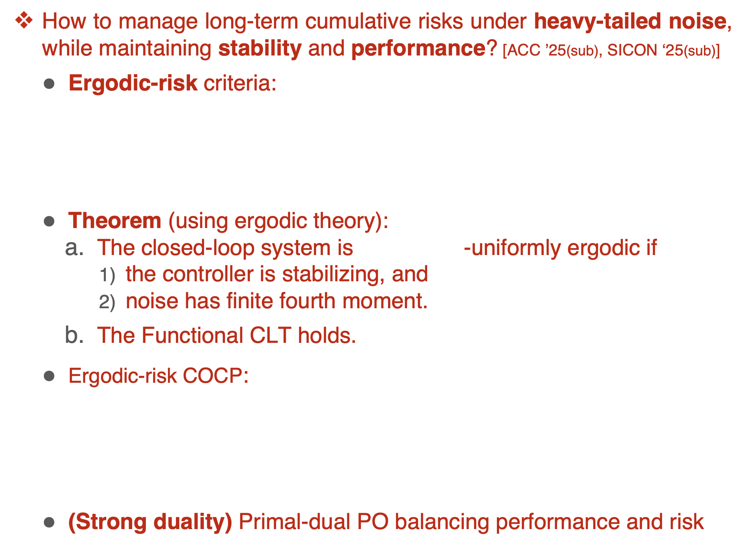
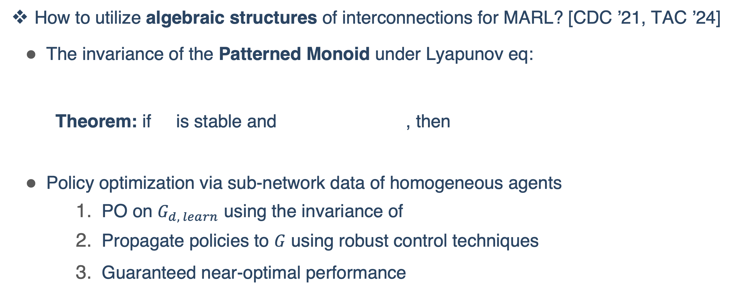
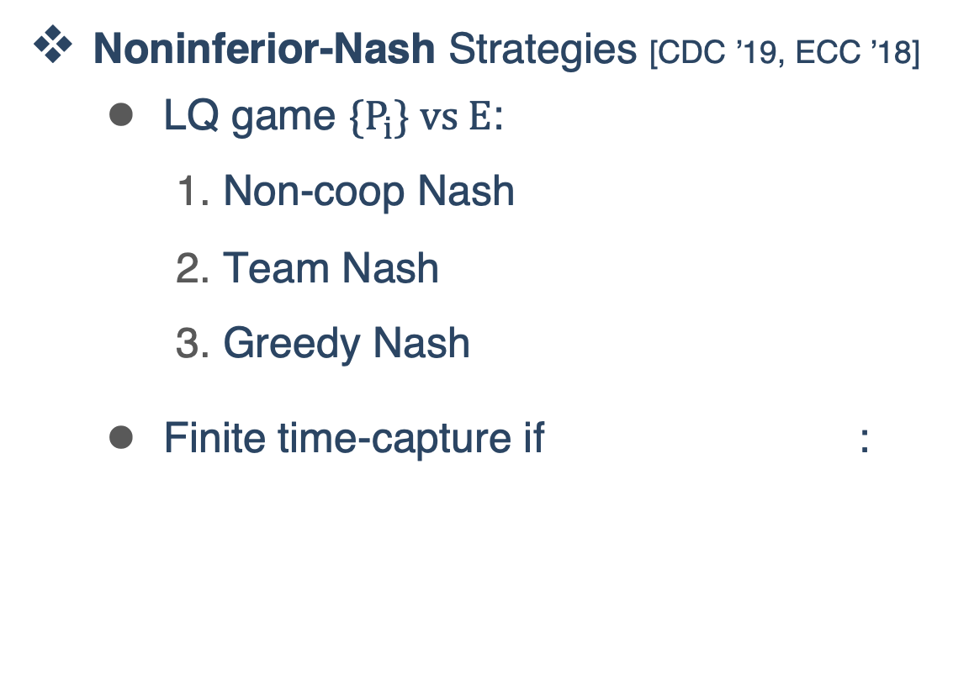
Shahriar Talebi (Harvard University)
How to utilize the geometry of policies for learning efficiently under constraints? [CDC ’22, TAC ’24]
Riemannian geometry of stabilizing policies for LTI systems
Riemannian Gradient/Newton Descent for constrained LQR
RGD / RND:
05
Can we achieve real-time online stabilization and control for unstable systems? [CDC ’20, TAC ’22]
is Regularizable if is stable,
“a geometric criterion characterizing finite-time stabilization property”
Theorem: The certainty-equivalent minimum-energy control
stabilizes is regularizable,
generates informative data
Geometry
Stabilization
04
01
or
Autonomy
and AI
Performance guarantees:
The “instability number of order t”:
Geometric consensus to RCM on bi-invariant Lie groups: [CDC ’23, CCTA ’23]
RCM:
?
Multi-agent
Inference
02
!
03
Output-feedback and distributed stabilization
Geometric classification of control-affine systems
Risk
Generalization to robust, decentralized policies
Interactions with the geometry of stable manifolds
How to utilize algebraic structures of interconnections for MARL? [CDC ’21, TAC ’24]
The invariance of the Patterned Monoid under Lyapunov eq:
Theorem: if is stable and , then
Policy optimization via sub-network data of homogeneous agents
PO on $G_{d, learn}$ using the invariance of
Propagate policies to $G$ using robust control techniques
Guaranteed near-optimal performance
How to manage long-term cumulative risks under heavy-tailed noise, while maintaining stability and performance? [ACC ’25(sub), SICON ‘25(sub)]
Ergodic-risk criteria:
Theorem (using ergodic theory):
The closed-loop system is -uniformly ergodic if
the controller is stabilizing, and
noise has finite fourth moment.
The Functional CLT holds.
Ergodic-risk COCP:
(Strong duality) Primal-dual PO balancing performance and risk
How to efficiently infer from partially observable systems with unknown noise or high-dim measurements? [ACC ’23, NeurIPS ’23]
Optimal MSE estimation without noise covariances :
Filtering policy optimization via Estimation-Control duality:
SysID from high-dimensional observation (applications in meta-learning): [ICML ’24]
High-dim SysID:
Complexity
Sub-network distributed games [CDC ’19]
“Team-based dual averaging”:
No-regret guarantee
Noninferior-Nash Strategies [CDC ’19, ECC ’18]
LQ game ${\{P}_{i}\} vs E$:
Non-coop Nash
Team Nash
Greedy Nash
Finite time-capture if :
Time-varying, partially unknown settings
Optimal SysID through nonlinear high-dim observations
Distributional policy optimization for stochastically dominant policies
MARL in heterogeneous, non-cooperative settings

